Slide 1
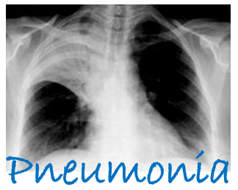
Ventilator Associated Pneumonia Events: Surveillance versus Treatment
Eric Ramos, MD
Chief Medical Officer, Long Beach Medical Center
Board Member Nevada Antimicrobial Stewardship
Jennifer Sanguinet, BSIS, MBA-HCM, FAPIC,
Director, Infection Prevention, Sunrise Hospital & Medical Center
Board Member Nevada Antimicrobial Stewardship

Slide 2
Objectives:
Identify the criteria used to meet NHSN and/or clinical definitions for pneumonia in diverse healthcare settings
Appropriately apply current treatment guidelines for pneumonia in the different settings
Describe at least three potential antibiotic resistance concerns for pneumonia treatment

Slide 3
The Results are in…..
Mortality
48,632
15.1 / 100,000 (2016)
Vaccination
65 & Over
69% (2017)
ED Visits 544,000 (2015)
16% of all deaths children < 5 years old ~ 2,400 children / day (2015)
#1 most common reason for US children to be hospitalized
1,000,000 Adults Seek Care in Hospital Each Year
Aggregate cost of nearly $9.5 billion for 960,000 hospital stays (2013)
50% of Sepsis & Septic Shock caused by Pneumonia

Slide 4
What about Nevada???
All Site State Specific Changes in Standardized Infection Ratios (SIR) for VAE and Standardized Utilization Ratios (SUR) between 2016 and 2017:
State | % Increase SIR | Change in SUR
Arkansas | 63% | No Change
Louisiana | 46% | Decrease by 9%
Nevada | 30% | No Change
Missouri | 24% | No Change
New Jersey | 17% | Increase by 10%
Virginia | 10% | Decrease by 3%

Slide 5
Hospital Acquired
NHSN Definitions are used to define the event from surveillance standpoint
Clinical manifestation is used to define for the treatment
What happens when the two misalign?
NHSN for IP is always the way
Clinical signs is always the way for treatment
The Key is to understand the difference→
Treatment→Clinical Rules
Surveillance→NHSN Definitions Rule

Slide 6
Ventilator-associated Condition (VAC)
Always starts with PEEP or FIO₂
Minimum of 4 calendar days on ventilator
At least two days of stable or decreasing numbers before increase occurs (minimum number on those days maintained for at least 1 hour)
Increase is by FIO₂ > or = 0.20 over baseline
Increase is by PEEP > or = 3 cmH20 over baseline
Increase stays or continues up for at least two consecutive calendar days
This means that the patient has had stability in the ventilator for at least two calendar days, increased demands, and continued increase or new stable high for at least 2 or more days after the initial baseline

Slide 7
Examples-VAC or Not?
Day 1 | Day 2 | Day 3 | Day 4 | Day 5
PEEP 5 | PEEP 5 | PEEP 5 | PEEP 8 | PEEP 9
FIO₂ 0.25 | 0.25 | 0.25 | 0.55 | 0.65
PEEP 5 FIO₂ 0.60 | PEEP 5 0.60 | PEEP 5 0.70 | PEEP 5 0.70 | PEEP 5 0.75
PEEP 5 | PEEP 8 | PEEP 7 | PEEP 8 | PEEP 8

Slide 8
Infection-related Ventilator-associated Complication (IVAC)
MEETS VAC
On or after day 3 within 2 days before or after the date of event in VAC
Temp greater than 38 degrees or less than 36 degrees (Celcius) OR
WBC >12,000 cm/mm3 or <4,000 cm/mm3
AND
New Qualifying microbial agent is started and continued for > 4 qualifying Antimicrobial days

Slide 9
Examples- IVAC or Not?
Day 1 | Day 2 | Day 3 VAE Window | Day 4 VAE Window | Day 5 VAE Window | Day 6 VAE Window | Day 7
FIO₂ 0.25 | 0.25 | 0.25 | 0.55 VAC (VAE Date) | 0.65 | 0.35 | 0.35
TMax 101 | 100.4 | 100.3 | 100 | 99.8 | 99.9 | 101
WBC 13.1 |  | 14.0 (Yes) |  | 12.5 (Yes) |  | 14.1
Antibiotics: Vanco (IV) | Vanco | Levaquin QD 1 | Levaquin QD 2 | Levaquin Ceftriaxone QD 3 | Ceftriaxone QD 4 | Ceftriaxone

Slide 10
Possible Ventilator-associated Pneumonia
Positive culture from one of the following:
Endotracheal Aspirate (>10⁵)
Bronch Lavage (>10⁴)
Lung Tissue (>10⁴)
Protected Specimen Brushing (>10³)
OR
Purulent secretions PLUS positive culture not meeting above cfu thresholds from Sputum, Endo trach aspirate, Bronch Lavage, Lung Tissue or Protected Specimen Brushing
OR
One of the following positive tests
Pleural fluid with organism
Lung histopathology (abscess, evidence of parenchyma or evidence of infection)
Diagnostic Legionella test
Diagnostic flu, rsv, adenovirus, parainfluenza, rhinovirus, human metapneumovirus, coronavirus

Slide 11
Examples-PVAP or Not?
Day 1 | Day 2 | Day 3 VAE Window | Day 4 VAE Window VAE DATE | Day 5 VAE Window | Day 6 VAE Window | Day 7
FIO₂ 0.25 | 0.25 | 0.25 | 0.55 | 0.65 | 0.35 | 0.35
WBC |  | 14.0
Antibiotics: |  | Levaquin QD 1 | Levaquin QD 2 | Levaquin Ceftriaxone QD 3 | Ceftriaxone QD 4
Cultures: ET Aspirate >10,000 Pseudomonas |  | Sputum 1,000 Serratia |  |  |  | Pleural fluid culture Enterococcus

Slide 12
Adult Non-ventilator associated: PNU1, PNU2, PNU3
PNU1-Clinically Defined Pneumonia
Chest Xray- Two or more serial with at least one of the following-Unless no underlying pulmonary or cardiac disease, then one is acceptable:
New and Persistent OR Progressive and Persistent
Infiltrate
Consolidation
Cavitation
Pneumatoceles, in infants <1 yearold
At least one of the following:
Fever
Leukopenia or leukcytosis
For adults > 70 years, altered mental status with no other recognized cause

Slide 13
Adult Non-ventilator associated: PNU2
PNU2-Common Bacterial/Fungal Pathogens + Spec Lab Findings
Chest Xray- Two or more serial with at least one of the following-Unless no underlying pulmonary or cardiac disease, then one is acceptable with New and Persistent OR Progressive and Persistent: Infiltrate, Consolidation, Cavitation, Pneumatoceles, in infants <1 year old- Unless no underlying pulmonary or cardiac disease then one is acceptable
And At least one of the following:
Fever, Leukopenia or leukocytosis, For adults > 70 years, altered mental status with no other recognized cause
And at least one of the following:
New onset of purulent sputum or change in sputum character or increase resp secretions or suctioning requirements
New onset or worsening cough, or dyspnea or tachypnea
Rales or bronchial breath sounds
Worsening gas exchange
And at least one of the following:
Organism identified from blood, pleural fluid, tissue culture or quantitative from BAL, protected specimen brushing or endotracheal aspirate
Positive histopathologic exam for abscess or lung parenchyma
Positive Virus, bordatella, Legionella, Chlamydia or Mycoplasma from respiratory secretions or tissue
Fourfold rise in paired sear IGG for pathogen, or Legionella pneumophila serogroup1 titer to >1:128
Detection of L. pneumophila serogroup 1 antigens in urine by RIA or EIA

Slide 14
Adult Non-ventilator associated: PNU3
PNU3-Immunocompromised patients
Chest Xray- Two or more serial with at least one of the following-Unless no underlying pulmonary or cardiac disease, then one is acceptable with New and Persistent OR Progressive and Persistent: Infiltrate, Consolidation, Cavitation, Pneumatoceles, in infants <1 year old- Unless no underlying pulmonary or cardiac disease then one is acceptable
And At least one of the following:
Fever, Leukopenia or leukocytosis, For adults > 70 years, altered mental status with no other recognized cause
And at least one of the following:
New onset of purulent sputum or change in sputum character or increase resp secretions or suctioning requirements
New onset or worsening cough, or dyspnea or tachypnea
Rales or bronchial breath sounds
Worsening gas exchange
Hemoptysis
Pleuritic chest pain
And at least one of the following:
Candida spp from blood and one from sputum, endotracheal aspirate, BAL or protected specimen brushing
Evidence of fungi from BAL, protected specimen brushing or endotracheal aspirate from one of the following: Direct microscopic exam, positive culture of fungi, or non-culture diagnostic test
OR
Any Laboratory criteria defined from PNU2

Slide 15
Peds VAE
Always starts with MAP (Mean Airway Pressure) or FIO₂
Minimum of 4 calendar days on ventilator
At least two days of stable or decreasing numbers before increase occurs (minimum number on those days maintained for at least 1 hour)
Increase is by FIO₂ > or = 0.25 over baseline
Increase is by MAP > or = 4 cmH20 over baseline
For <30 days old: MAP 0-8 = 8
For >30 days old: MAP 0-8 = 10
Increase stays or continues up for at least two consecutive calendar days
This means that the patient has had stability in the ventilator for at least two calendar days, increased demands, and continued increase or new stable high for at least 2 or more days after the initial baseline

Slide 16
Examples
Day 1 | Day 2 | Day 3 Peds VAE if < 30 days age | Day 4 | Day 5
MAP 12 | MAP 8 | MAP 15 | MAP 9 | MAP 8
FIO₂ 0.55 | 0.70 | 0.65 | 0.80 | 0.60
MAP 8 FIO₂ 0.60 | MAP 8 0.60 | MAP 12 0.70 | MAP 12 0.70 | MAP 8 0.75
MAP 8 | MAP 8 | MAP 9 | MAP 10 | MAP 12
Notes:
Assum <30 days old changes all 0-8 to 8
If > or = 30 days changes all 0-8 to 10

Slide 17
Cause of Ventilator-Associated Pneumonia
Long term use of ventilator
Late Removal of ventilator
Mismanagement of ventilator
Ignoring ventilator bundles:
Elevation of head of bed
Daily “sedation vacations” and assessment of readiness to extubate
Peptic ulcer disease prophylaxis
Deep vein thrombosis prophylaxis
Not cleaning or disinfecting per guidelines of ALL equipment
Notes:
AHRQ Innovations Exchanged: Ventilator Bundle Checklist Retrieved from https://innovations.ahrq.gov/qualitytools/ventilator-bundle-checklist

Slide 18
Non-ventilator associated pneumonia
Non-Ventilator-associated: No Ventilator to complicate things, but pneumonia nonetheless
Healthcare Acquired
Patient was admitted to a healthcare facility (not an acute care hospital) during, just before, or at the time of onset.
Long Term Care
Rehabilitation
Treatment may be different depending on the organisms prevalent at the facility that the patient was exposed
Community-Acquired Pneumonia
Identified in patients who have not been admitted to a healthcare facility or hospital prior to onset of symptoms
Emergency Departments
Urgent Care/Clinics
Notes:
Centers for Disease Control and Prevention. (2018). Pneumococcal recommendations for older adults. Retrieved from https://www.cdc.gov/pneumonia/prevention.html

Slide 19
Let’s get clinical!
Use Objective criteria such as:
Severity of illness as defined by: confusion, uremia, respiratory rate, low blood pressure, age 65 or greater (CURB-65)
OR
Pneumonia Severity Index: The PSI/PORT Score can be used in the clinic or emergency department setting to risk stratify a patient’s community acquired pneumonia.
Since points are assigned by absolute age in the PSI, it may underestimate severe pneumonia in an otherwise young healthy patient.
Consider sepsis in patients with pneumonia; the PSI was developed prior to aggressive sepsis screening with lactate testing.
Though a patient may be categorized as appropriate for outpatient treatment, assess potential barriers to treatment such as vomiting, alcohol/drug use, psychosocial conditions, or cognitive impairments.
Any patient over 50 years of age is automatically classified as risk class 2, even if they otherwise are completely healthy and have no other risk criteria.
PLUS
Minimum Diagnostic:
Routine to identify etiologic diagnosis for outpatients is optional
Blood samples and sputum (in patients with productive cough)-Hospital Pts.

Slide 20
Prevention Strategies
Make sure you are looking at it- all pneumonia not just ventilated
Encourage vaccination for appropriate populations
Use noninvasive positive pressure ventilation when appropriate
Manage without sedation when possible and interrupt daily when not
Perform spontaneous breathing trials with sedative off
Facilitate early mobility
Use endotracheal tubes with subglottic secretion drainage ports for patients expecting more than 72 hours on vent
Regular chg oral care
Regular mechanical tooth brushing
Notes:
Klompas et al. (2014). Strategies to prevent Ventilator-Associated Pneumonia in Acute Care Hospitals: 2014 Update. Infection Control and Hospital Epidemiology, 35I(8). 915-936. doi: https://www.jstor.org/stable/10.1086/677144

Slide 21
What about the bugs?
Bordatella Pertussis
Adenovirus
MRSA
Rhinovirus
RSV
Strep Pneumo
Pneumocystis Pneumonia
Pneumococcal
Parainfluenza
Mycoplasma
Legionnaires

Slide 22
Patient Self-Prevention!
Get VACCINATED!
Get a dose of the pneumococcal conjugate vaccine (PCV13) first. Then get a dose of the pneumococcal polysaccharide vaccine (PPSV23) at least 1 year later.
If you’ve already received PPSV23, get PCV13 at least 1 year after receipt of the most recent PPSV23 dose.
If you’ve already received a dose of PCV13 at a younger age, CDC does not recommend another dose.
Stop Smoking! Avoid Second-hand smoke.
Regular Physicals
If Sick, complete ALL therapies as prescribed..Avoid Multi-drug Resistant Situations.

Slide 23
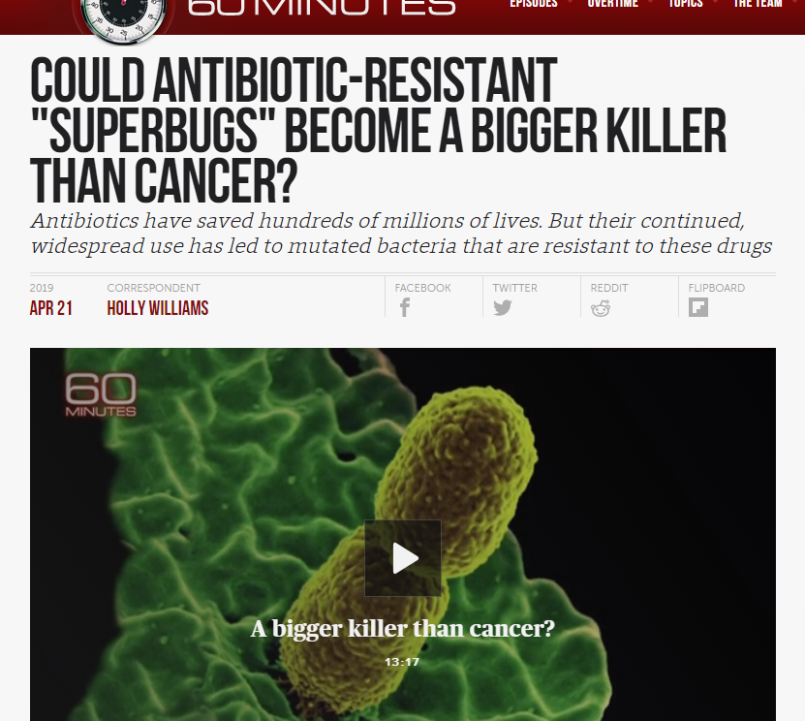
Pneumonia happens..What do we do? We treat which causes…..
Just a little Google Scholar Search!
Gao, B., Li, X., Yang, F., Chen, W., Zhao, Y., Bai, G., & Zhang, Z. (2019). Molecular Epidemiology and Risk Factors of Ventilator-Associated Pneumonia Infection Caused by Carbapenem-Resistant Enterobacteriaceae. Frontiers in pharmacology, 10, 262. doi:10.3389/fphar.2019.00262
Xu, H., Huo, C., Sun, Y., Zhou, Y., Xiong, Y., Zhao, Z., … Chen, Y. (2018). Emergence and molecular characterization of multidrug-resistant Klebsiella pneumoniae isolates harboring bla_{CTX-M-15} extended-spectrum β-lactamases causing ventilator-associated pneumonia in China. Infection and drug resistance, 12, 33–43. doi:10.2147/IDR.S189494
Huang, Y., Zhou, Q., Wang, W., Huang, Q., Liao, J., Li, J., … Tu, M. (2019). Acinetobacter baumannii Ventilator-Associated Pneumonia: Clinical Efficacy of Combined Antimicrobial Therapy and in vitro Drug Sensitivity Test Results. Frontiers in pharmacology, 10, 92. doi:10.3389/fphar.2019.00092
Pérez, A. et al. (2019). High incidence of MDR and XDR Pseudomonas aeruginosa isolates obtained from patients with ventilator-associated pneumonia in Greece, Italy and Spain as part of the MagicBullet clinical trial, Journal of Antimicrobial Chemotherapy, https://doi.org/10.1093/jac/dkz030
Park, H., Cho, J., Kim, H., Ha, S., Jeong, S., Byun, M. (2019). Colistin monotherapy versus colistin/rifampicin combination therapy in pneumonia caused by colistin-resistant Acinetobacter baumannii: A randomised controlled trial. Journal of Gloabla Antimicrobial Resistance, 17, 66-71. doi: 10.1016/j.jgar.2018.11.016
Notes:
Google Scholar search for “Cause of ventilator associated pneumonia” Since 2019…..Top ten had these 5 results

Slide 24
Follow the guidelines
Community-Acquired Pneumonia: Non-healthcare exposed patients prior to onset
The Management of Community-Acquired Pneumonia in Adults Cdc-pdf[46 pages] The Infectious Diseases Society of America and American Thoracic Society developed these consensus guidelines.
The Management of Community-Acquired Pneumonia in Infants and Children Older Than 3 Months of Age Cdc-pdf[52 pages] The Pediatric Infectious Diseases Society and Infectious Diseases Society of America developed these clinical practice guidelines.
Healthcare-Associated Pneumonia: Patients exposed to healthcare facility prior to onset (LTC, SNF, Hospital, Rehab)
Guidelines for Preventing Health-Care-Associated Pneumonia, 2003 Cdc-pdf[179 pages] CDC and the Healthcare Infection Control Practices Advisory Committee developed these recommendations.
Management of Adults with Hospital-acquired and Ventilator-associated Pneumonia, 2016 Cdc-pdf[51 pages] The Infectious Diseases Society of America and American Thoracic Society developed these clinical practice guidelines.
Strategies to Prevent Ventilator-Associated Pneumonia in Acute Care Hospitals, 2014 The Society of Healthcare Epidemiology of America and Infectious Diseases Society of America developed these guidelines.
Notes:
Centers for Disease Control and Prevention. (2018). Management and prevention guidelines. Retrieved from https://www.cdc.gov/pneumonia/management-prevention-guidelines.html

Slide 25
Risk Factors
Older age-the incidence increases to 2,000/100,000 in patients ≥65yrs old
Comorbidities- COPD, Asthma, chronic heart disease, stroke, diabetes, malnutrition and immunocompromised
Viral respiratory track infection
Impaired airway protection
Smoking and alcohol overuse
Crowded living conditions
Exposure to environmental toxins(solvent, paint, gasoline)

Slide 26
Preventing Ventilator Associated Pneumonia
Awakening Trials
Breathing Trials
Coordinated effort to stop sedation for Spontaneous Breathing Trial
Delirium assessment
Early Ambulation
Family
Elevate Head of Bed 30-45 degrees
Peptic Ulcer disease prophylaxis
Deep vein Thrombosis prophylaxis
Daily oral care with CHG

Slide 27
Prevention in Long Term Care Facilities
Prevention requires immunizations including Pneumovax and yearly Influenza vaccinations including staff and visitors
Consider restricting visitors during influenza season
Residents should be treated as Immunocompromised patients with a lower threshold to evaluate for infections
Maintaining Excellent Hand washing compliance is imperative

Slide 28
Treatments in ED
Evaluation includes:
Complete History
Focus on travel, Immunization history, living conditions, risk factors for atypical pneumonia, Don’t forget about TB
CBC, CXR, Oxygen Saturation, comorbidities(Chronic lung disease, CHF, Stroke, Diabetes, Malnutrition, Immunocompromised, Smoking and alcohol abuse)
Thinking sepsis, get a lactate level!
CXR may be initially negative
Decision to admit or treat as outpatient
PSI or CURB-65 can help guide inpatient vs outpatient Tx

Slide 29
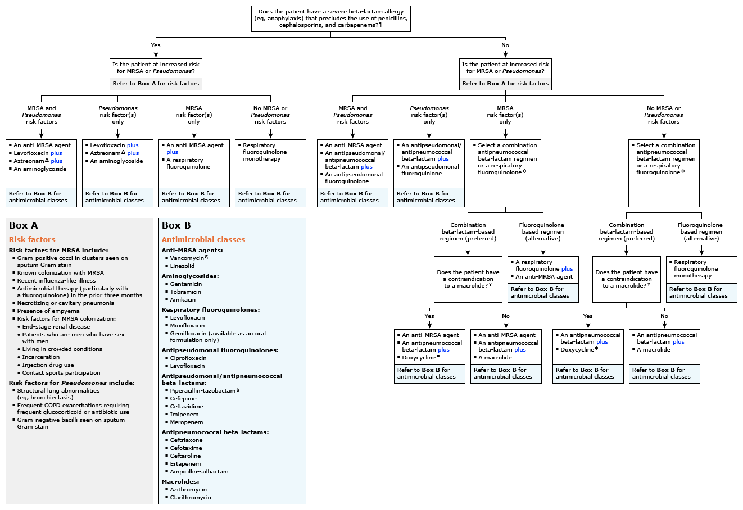
Community-acquired pneumonia: Empiric antibiotic selection for adults admitted to the general medical ward*

Slide 30
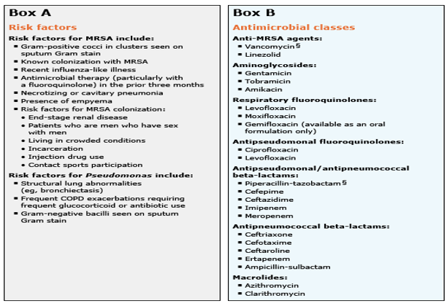
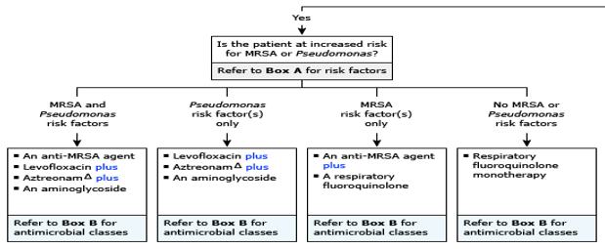
Community-acquired pneumonia: Empiric antibiotic selection for adults admitted to the general medical ward*

Slide 31
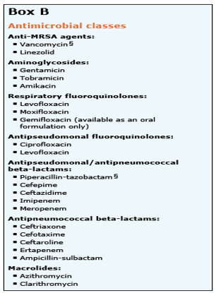

Slide 32
Specific antibiotic therapy for pneumonia in children
Pathogen | Parenteral therapy | Oral therapy (step-down therapy or mild infection)
Streptococcus pneumoniae with MICs for penicillin ≤2.0 mcg/mL | Preferred: Ampicillin (150 to 200 mg/kg/day every 6 hours) or penicillin (200,000 to 250,000 units/kg/day every 4 to 6 hours) Alternatives: Ceftriaxone (50 to 100 mg/kg/day every 12 to 24 hours) (preferred for parenteral outpatient therapy) or cefotaxime (150 mg/kg/day every 8 hours); may also be effective: clindamycin* (40 mg/kg/day every 6 to 8 hours) or vancomycin (40 to 60 mg/kg/day every 6 to 8 hours) | Preferred: Amoxicillin (90 mg/kg/day in two doses or 45 mg/kg/day in three doses) Alternatives: Second- or third-generation cephalosporin (cefpodoxime, cefuroxime, cefprozil); levofloxacin, if susceptible (16 to 20 mg/kg/day in two doses for children 6 months to 5 years old and 8 to 10 mg/kg/day once daily for children 5 to 16 years old; maximum daily dose 750 mg) or linezolid (30 mg/kg/day in three doses for children <12 years old and 20 mg/kg/day in two doses for children ≥12 years old)
S. pneumoniae resistant to penicillin, with MICs ≥4.0 mcg/mL | Preferred: Ceftriaxone (100 mg/kg/day every 12 to 24 hours) Alternatives: Ampicillin (300 to 400 mg/kg/day every 6 hours), levofloxacin (16 to 20 mg/kg/day every 12 hours for children 6 months to 5 years old and 8 to 10 mg/kg/day once daily for children 5 to 16 years old; maximum daily dose 750 mg), or linezolid (30 mg/kg/day every 8 hours for children <12 years old and 20 mg/kg/day every 12 hours for children ≥12 years old); may also be effective: clindamycin* (40 mg/kg/day every 6 to 8 hours) or vancomycin (40 to 60 mg/kg/day every 6 to 8 hours) | Preferred: Levofloxacin (16 to 20 mg/kg/day in two doses for children 6 months to 5 years and 8 to 10 mg/kg/day once daily for children 5 to 16 years, maximum daily dose 750 mg), if susceptible, or linezolid (30 mg/kg/day in three doses for children <12 years and 20 mg/kg/day in two doses for children ≥12 years) Alternative: Clindamycin* (30 to 40 mg/kg/day in three doses)
Group A Streptococcus | Preferred: Penicillin (100,000-250,000 units/kg/day every 4 to 6 hours) or ampicillin (200 mg/kg/day every 6 hours) Alternatives: Ceftriaxone (50 to 100 mg/kg/day every 12 to 24 hours) or cefotaxime (150 mg/kg/day every 8 hours); may also be effective: clindamycin, if susceptible (40 mg/kg/day every 6 to 8 hours) or vancomycin¶ (40 to 60 mg/kg/day every 6 to 8 hours) | Preferred: Amoxicillin (50 to 75 mg/kg/day in two doses), or penicillin V (50 to 75 mg/kg/day in three or four doses) Alternative: Clindamycin if susceptible (40 mg/kg/day in 3 doses)

Slide 33
Pathogen | Parenteral therapy | Oral therapy (step-down therapy or mild infection)
Staphylococcus aureus, methicillin susceptible (combination therapy not well studied) | Preferred: Cefazolin (150 mg/kg/day every 8 hours) or semisynthetic penicillin (eg, oxacillin or nafcillin 150 to 200 mg/kg/day every 6 to 8 hours) Alternatives: Cindamycin* (40 mg/kg/day every 6 to 8 hours) or vancomycin (40 to 60 mg/kg/day every 6 to 8 hours) | Preferred: Cephalexin (75 to 100 mg/kg/day in three or four doses) Alternative: Clindamycin* (30 to 40 mg/kg/day in three or four doses)
S. aureus, methicillin resistant, susceptible to clindamycin (combination therapy not well studied) | Preferred: Vancomycin (40 to 60 mg/kg/day every 6 to 8 hours or dosing to achieve an AUC/MIC ratio of >400) or clindamycin (40 mg/kg/day every 6 to 8 hours) Alternatives: Linezolid (30 mg/kg/day every 8 hours for children <12 years old and 20 mg/kg/day every 12 hours for children ≥12 years old) | Preferred: Clindamycin (30 to 40 mg/kg/day in three or four doses) Alternatives: Linezolid (30 mg/kg/day in three doses for children <12 years and 20 mg/kg/day in two doses for children ≥12 years)
S. aureus, methicillin resistant, resistant to clindamycin (combination therapy not well studied) | Preferred: Vancomycin (40 to 60 mg/kg/day every 6 to 8 hours or dosing to achieve an AUC/MIC ratio of >400) Alternatives: Linezolid (30 mg/kg/day every 8 hours for children <12 years old and 20 mg/kg/day every 12 hours for children ≥12 years old) | Preferred: Linezolid (30 mg/kg/day in three doses for children <12 years and 20 mg/kg/day in two doses for children ≥12 years old) Alternatives: None; entire treatment course with parenteral therapy may be required

Slide 34
Pathogen | Parenteral therapy | Oral therapy (step-down therapy or mild infection)
Haemophilus influenzae, typeable (A-F) or non-typeable | Preferred: Ampicillin (150 to 200 mg/kg/day every 6 hours) if β-lactamase negative; ceftriaxone (50 to 100 mg/kg/day every 12 to 24 hours) or cefotaxime (150 mg/kg/day every 8 hours) if β-lactamase positive Alternatives: Ciprofloxacin (30 mg/kg/day every 12 hours) or levofloxacin (16 to 20 mg/kg/day every 12 hours for children 6 months to 5 years old and 8 to 10 mg/kg/day once daily for children 5 to 16 years old; maximum daily dose 750 mg) | Preferred: Amoxicillin (75 to 100 mg/kg/day in three doses) if β-lactamase negative or amoxicillin clavulanate (amoxicillin component, 45 mg/kg/day in three doses or 90 mg/kg/day in two doses) if β-lactamase positive Alternatives: Cefdinir, cefixime, cefpodoxime, or ceftibuten
Mycoplasma pneumoniae | Preferred: Azithromycin (10 mg/kg on days 1 and 2 of therapy; transition to oral therapy if possible) Alternatives: Erythromycin lactobionate (20 mg/kg/day every 6 hours) or levofloxacin (16 to 20 mg/kg/day every 12 hours for children 6 months to 5 years old and 8 to 10 mg/kg/day once daily for children 5 to 16 years old; maximum daily dose 750 mg) | Preferred: Azithromycin (10 mg/kg on day 1, followed by 5 mg/kg/day once daily on days 2 to 5) Alternatives: Clarithromycin (15 mg/kg/day in two doses) or erythromycin (40 mg/kg/day in four doses); for children >7 years old, doxycycline (2 to 4 mg/kg/day in two doses); for adolescents with skeletal maturity, levofloxacin (500 mg once daily) or moxifloxacin (400 mg once daily)
Chlamydia trachomatis or Chlamydia pneumoniae | Preferred: Azithromycin (10 mg/kg on days 1 and 2 of therapy; transition to oral therapy if possible) Alternatives: Erythromycin lactobionate (20 mg/kg/day every 6 hours) or levofloxacin (16 to 20 mg/kg/day in two doses for children 6 months to 5 years old and 8 to 10 mg/kg/day once daily for children 5 to 16 years old; maximum daily dose 750 mg) | Preferred: Azithromycin (10 mg/kg on day 1, followed by 5 mg/kg/day once daily days 2 to 5) Alternatives: Clarithromycin (15 mg/kg/day in two doses) or erythromycin (40 mg/kg/day in four doses); for children >7 years old, doxycycline (2 to 4 mg/kg/day in two doses); for adolescents with skeletal maturity, levofloxacin (500 mg once daily) or moxifloxacin (400 mg once daily)

Slide 35
Treatments in LTC/Rehab
Prevention requires immunizations including Pneumovax and yearly Influenza vaccinations including staff and visitors
Consider restricting visitors during influenza season
Residents should be treated as Immunocompromised patients with a lower threshold to evaluate for infections
Maintaining Hand washing compliance is imperative

Slide 36
Treatments in ED
Evaluation includes:
Complete History “If you listen to patients, they will tell you what’s wrong with them”
Focus on travel, Immunization history, living conditions, risk factors for atypical pneumonia, Don’t forget about TB
CBC, CXR, Oxygen Saturation, comorbidities(Chronic lung disease, CHF, Stroke, Diabetes, Malnutrition, Immunocompromised, Smoking and alcohol abuse)
Must rule out sepsis, get a lactate level!
CXR may be initially negative
Decision to admit or treat as outpatient
PSI or CURB-65 can help guide inpatient vs outpatient Tx

Slide 37
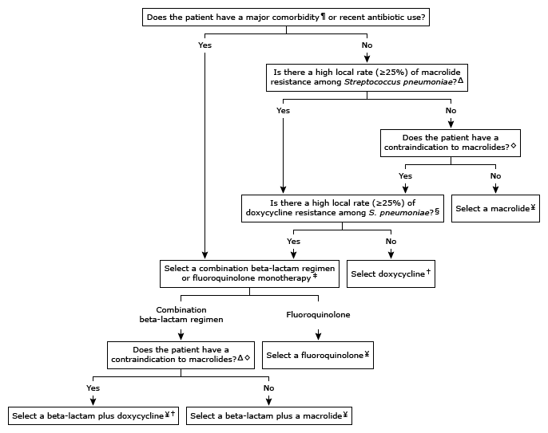
Community-acquired pneumonia: Empiric outpatient antibiotic selection in adults*

Slide 38
Preventing Antibiotic Resistance
Right Patient
Right Antibiotic
Right Time
Right Treatment
RIGHT PEOPLE FOCUSED ON THE PREVENTION!!

Slide 39
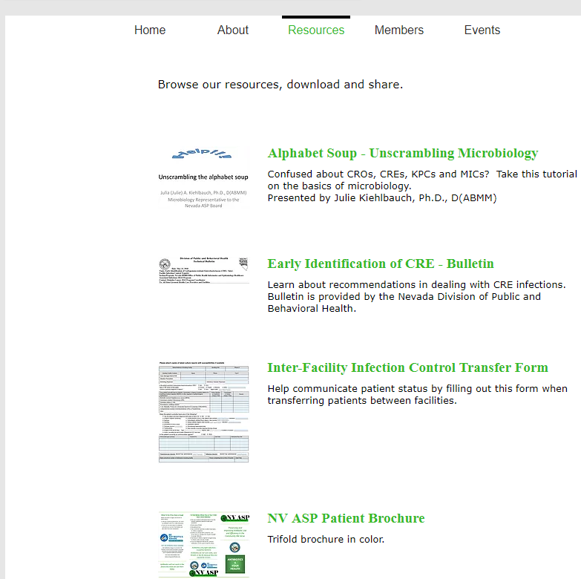
Nevada Antimicrobial Stewardship
Where does the State Stand?
We are going to find out…
Survey being sent soon to create a statewide dashboard of ASP status in all healthcare areas including acute, long term and outpatient.
Starting with Acute…goal to have out by June 1st
3 of the 4 goals are being touched today- Working with diverse community members to better align prescribing, planning and implementing antibiotics for the Nevadan communities!
https://www.nvasp.net/
Notes:
Work with key members of the NV ASP group to collaborate, stratify and unite overarching antibiotic stewardship programs across the care continuum including inpatient, outpatient, skilled nursing and long term care facilities, pharmacies, and dentistry to develop a broad picture and understanding of the antibiotic stewardship in Nevada.
Identify key organizations, partners, and community members that will facilitate and educate Nevadans on appropriateness of antibiotics, the need to follow prescription and care plans, and the poor outcomes including community impact when they are improperly used.
Identify, collect, and/or create best-practice, algorithms, and care plans for antibiotic prescribing including length from identified industry leaders, antibiograms, and systems for dissemination, education, and adherence to improve quality of care and continuity for Nevadans.

Slide 40
References
AHRQ Innovations Exchanged: Ventilator Bundle Checklist Retrieved from https://innovations.ahrq.gov/qualitytools/ventilator-bundle-checklist
American Thoracic Society. (2018). Top twenty pneumonia facts. Retrieved from https://www.thoracic.org/patients/patient-resources/resources/top-pneumonia-facts.pdf
Bradley, J. et al. (2011). The management of community-acquired pneumonia in infants and children older than 3 months of age: Clinical practice guidelines by The Pediatric Infectious Diseases Society and Infectious Diseases Society of America. Clinical Infectious Diseases, 53(7), e25–e76. doi: 10.1093/cid/cir531
Centers for Disease Control and Prevention. (2003). Guidelines for preventing health-care-associated pneumonia. Retrieved from https://www.cdc.gov/infectioncontrol/guidelines/pneumonia/index.html
Centers for Disease Control and Prevention. (2017). Pneumonia data for US. Retrieved from https://www.cdc.gov/nchs/fastats/pneumonia.htm
Centers for Disease Control and Prevention. (2018a). Pneumonia. Retrieved from https://www.cdc.gov/pneumonia/
Centers for Disease Control and Prevention. (2018b). State-based HAI prevention: Nevada. Retrieved from https://www.cdc.gov/hai/stateplans/state-hai-plans/nv.html
Centers for Disease Control and Prevention. (2019a). Healthcare-associated Infections: Current HAI progress report. Retrieved https://www.cdc.gov/hai/data/portal/progress-report.html
Centers for Disease Control and Prevention. (2019b). NHSN Patient Safety Component Manual. Retrieved from https://www.cdc.gov/nhsn/pdfs/pscmanual/pcsmanual_current.pdf
Fine, M.J. (2019). PSI/PORT Score: Pneumonia Severity Index for CAP. Retrieved from https://www.mdcalc.com/psi-port-score-pneumonia-severity-index-cap

Slide 41
References
Gao, B., Li, X., Yang, F., Chen, W., Zhao, Y., Bai, G., & Zhang, Z. (2019). Molecular Epidemiology and Risk Factors of Ventilator-Associated Pneumonia Infection Caused by Carbapenem-Resistant Enterobacteriaceae. Frontiers in pharmacology, 10, 262. doi:10.3389/fphar.2019.00262
Huang, Y., Zhou, Q., Wang, W., Huang, Q., Liao, J., Li, J., … Tu, M. (2019). Acinetobacter baumannii Ventilator-Associated Pneumonia: Clinical Efficacy of Combined Antimicrobial Therapy and in vitro Drug Sensitivity Test Results. Frontiers in pharmacology, 10, 92. doi:10.3389/fphar.2019.00092
Kalil, A. et al. (2016). Management of adults with hospital-acquired and ventilator-associated pneumonia: 2016 clinical practice guidelines by the Infectious Diseases Society of America and the American Thoracic Society. Clinical Infectious Diseases, 63(5), e61-111. doi: 10.1093;cid/ciw353
Klompas et al. (2014). Strategies to prevent Ventilator-Associated Pneumonia in Acute Care Hospitals: 2014 Update. Infection Control and Hospital Epidemiology, 35(8). 915-936. doi: https://www.jstor.org/stable/10.1086/677144
Mandell, L., Wunderink, R., Anzueto, A., Bartlett, J., Campbell, G., Dean, N., Dowell, S., File, T., Musher, D., Niederman, M., Torres, A., & Whitney, C. (2007). The management of community-acquired pneumonia in adults. Clinical Infectious Diseases, 44(Suppl 2), S27-72. doi: 10.1086/51159
Park, H., Cho, J., Kim, H., Ha, S., Jeong, S., Byun, M. (2019). Colistin monotherapy versus colistin/rifampicin combination therapy in pneumonia caused by colistin-resistant Acinetobacter baumannii: A randomised controlled trial. Journal of Gloabla Antimicrobial Resistance, 17, 66-71. doi: 10.1016/j.jgar.2018.11.016
Pérez, A. et al. (2019). High incidence of MDR and XDR Pseudomonas aeruginosa isolates obtained from patients with ventilator-associated pneumonia in Greece, Italy and Spain as part of the MagicBullet clinical trial, Journal of Antimicrobial Chemotherapy, https://doi.org/10.1093/jac/dkz030
Xu, H., Huo, C., Sun, Y., Zhou, Y., Xiong, Y., Zhao, Z., … Chen, Y. (2018). Emergence and molecular characterization of multidrug-resistant Klebsiella pneumonia isolates harboring extended-spectrum β-lactamases causing ventilator-associated pneumonia in China. Infection and drug resistance, 12, 33–43. doi:10.2147/IDR.S189494

